Slide 1
Chapter 16: Windows LAPS
Local administrator password management and operational administration

Slide 2
Chapter Summary
01 Show why unmanaged local admin passwords are a security risk
02 Explain how LAPS stores, rotates, and secures local administrator credentials
03 Keep the chapter grounded in administrative workflows and policy behavior
04 Reinforce repeatable administration, validation, and supportable design choices
Windows Server 2025 | Chapter 16 | Windows LAPS
02

Slide 3
What is LAPS?
Windows Local Administrator Password Solution (Windows LAPS) is a Windows feature that automatically manages and backs up the password of a local administrator account on your Microsoft Entra-joined or Windows Server Active Directory-joined devices.
A Microsoft solution for managing local administrator passwords on domain-joined devices.
Ensures each machine has a unique, regularly rotated local admin password.
Windows Server 2025 | Chapter 16 | Windows LAPS
03

Slide 4
Why LAPS matters
Attack Vectors Without LAPS
Password reuse across machines.
Lateral movement in attacks (Pass-the-Hash).
Insider threats.
Benefits of LAPS
Unique, randomised passwords.
Automatic password rotation.
Secure password storage in Active Directory or Entra ID.
Windows Server 2025 | Chapter 16 | Windows LAPS
04

Slide 5
LAPS evolution
Legacy LAPS: Stored in Active Directory, required MSI package.
Windows LAPS (2023+): Built into Windows 11, Windows Server 2022+, with Azure AD (Entra ID) integration.
Support for cloud-joined and hybrid devices.
Windows Server 2025 | Chapter 16 | Windows LAPS
05

Slide 6
Two LAPS Solutions
Legacy Microsoft LAPS
AD LAPS – MSI-based, AD only
Active Directory only
Requires schema extension
Separate MSI agent installed on devices
Managed via Group Policy
Retrieve passwords with LAPS UI or PowerShell
Windows LAPS (2023+)
Built into Windows, supports AD and Entra ID
Built into Windows 11 / Server 2022+
Supports Active Directory and Entra ID
Managed via Intune or Group Policy
Retrieve via Entra ID / Intune portal
PowerShell cmdlets available
Windows Server 2025 | Chapter 16 | Windows LAPS
06

Slide 7
Legacy Microsoft LAPS
Active Directory only
Requires schema extension
MSI agent installed on devices
Managed via Group Policy
Admins retrieve passwords with LAPS UI or PowerShell
Windows Server 2025 | Chapter 16 | Windows LAPS
07

Slide 8
Windows LAPS (New)
Built into Windows 11 / Server 2022+ (and updated Win10/Server 2019)
Supports Active Directory and Entra ID
Managed via Intune or Group Policy
Password retrieval via Entra ID / Intune portal
PowerShell cmdlets available
Windows Server 2025 | Chapter 16 | Windows LAPS
08

Slide 9
Key Differences
Feature | Legacy LAPS | Windows LAPS
Agent | Separate MSI | Built into Windows
Directory Support | AD only | AD & Entra ID
Management | Group Policy | Intune / Group Policy
Retrieval | UI / PowerShell | Intune, Entra ID, PowerShell
Schema Extension | Required | AD only
Cloud Support | No | Yes
Windows Server 2025 | Chapter 16 | Windows LAPS
09

Slide 10
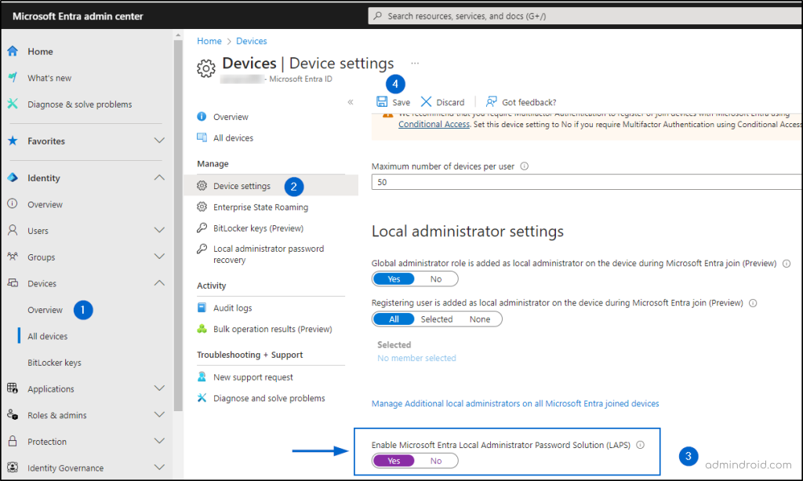
Enable LAPS in Entra Admin center
Windows Server 2025 | Chapter 16 | Windows LAPS
10

Slide 11
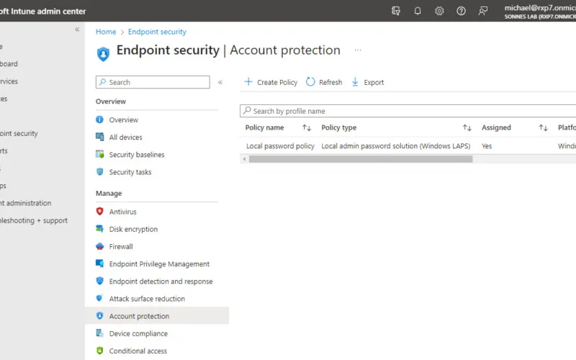
Creating a policy in Intune
Windows Server 2025 | Chapter 16 | Windows LAPS
11

Slide 12
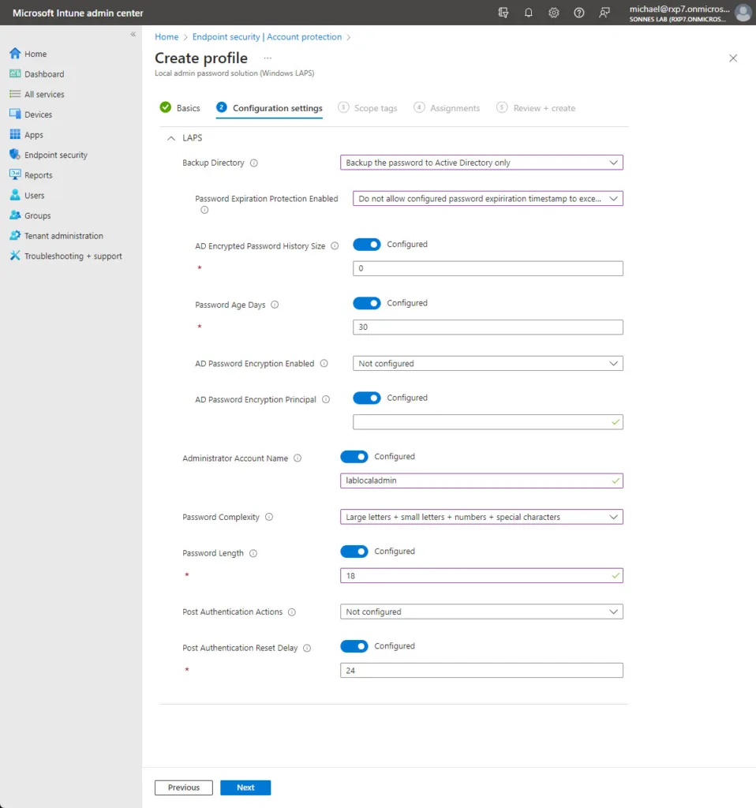
LAPS Intune profile settings
Windows Server 2025 | Chapter 16 | Windows LAPS
12

Slide 13
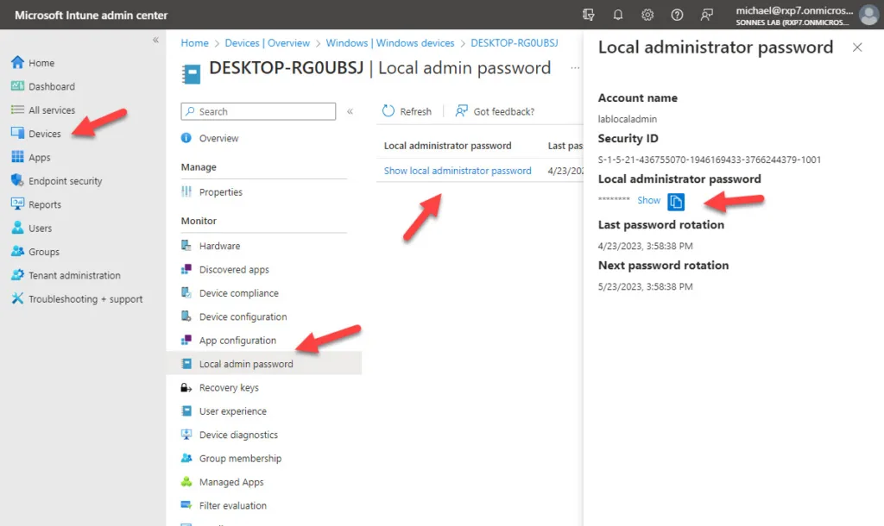
Retrieving a local admin password for a device
Windows Server 2025 | Chapter 16 | Windows LAPS
13

Slide 14
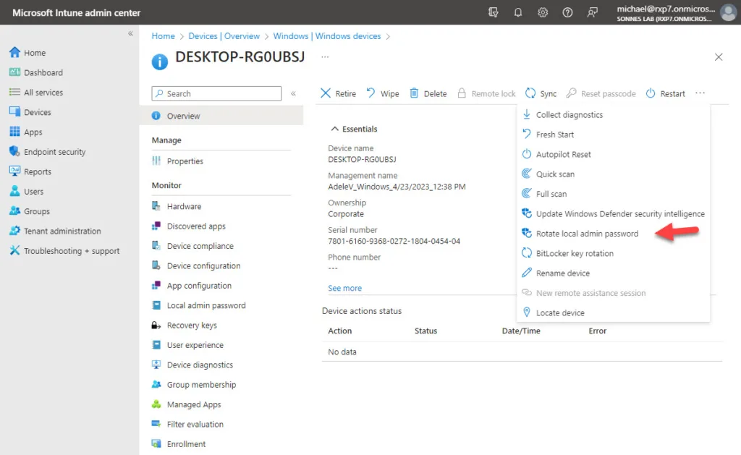
Rotating an admin password
Windows Server 2025 | Chapter 16 | Windows LAPS
14

Slide 15


Windows LAPS PowerShell Administration
Windows Server 2025 | Chapter 16 | Windows LAPS
15

Slide 16
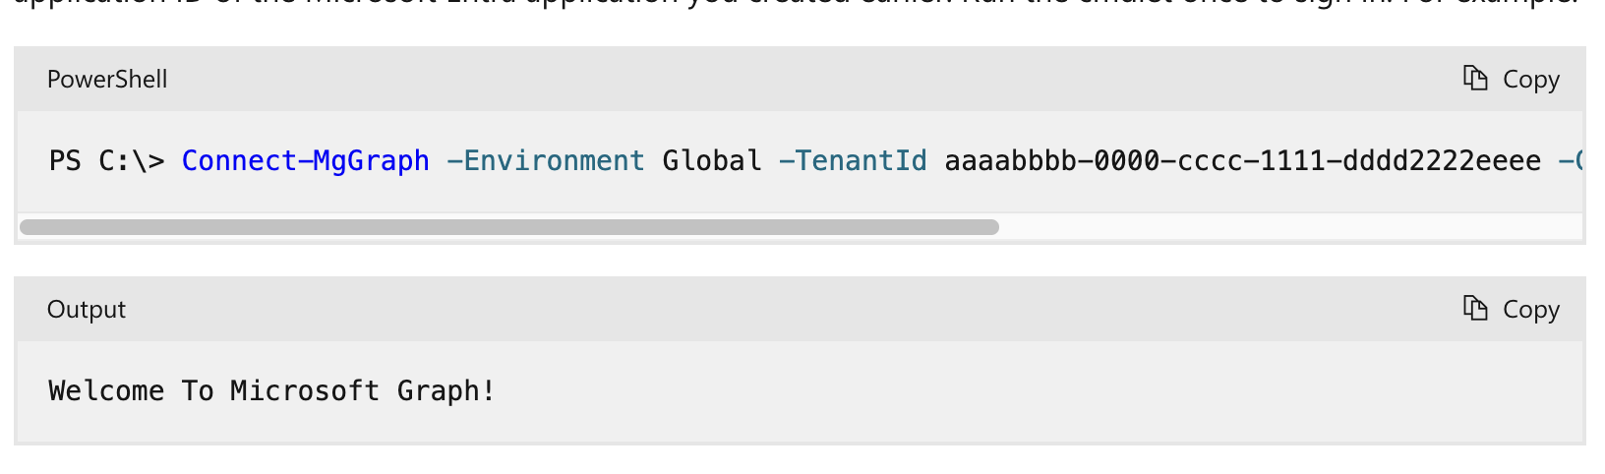
Connect to MS Graph
Full documentation
https://learn.microsoft.com/en-us/windows-server/identity/laps/laps-scenarios-azure-active-directory
Windows Server 2025 | Chapter 16 | Windows LAPS
16

Slide 17
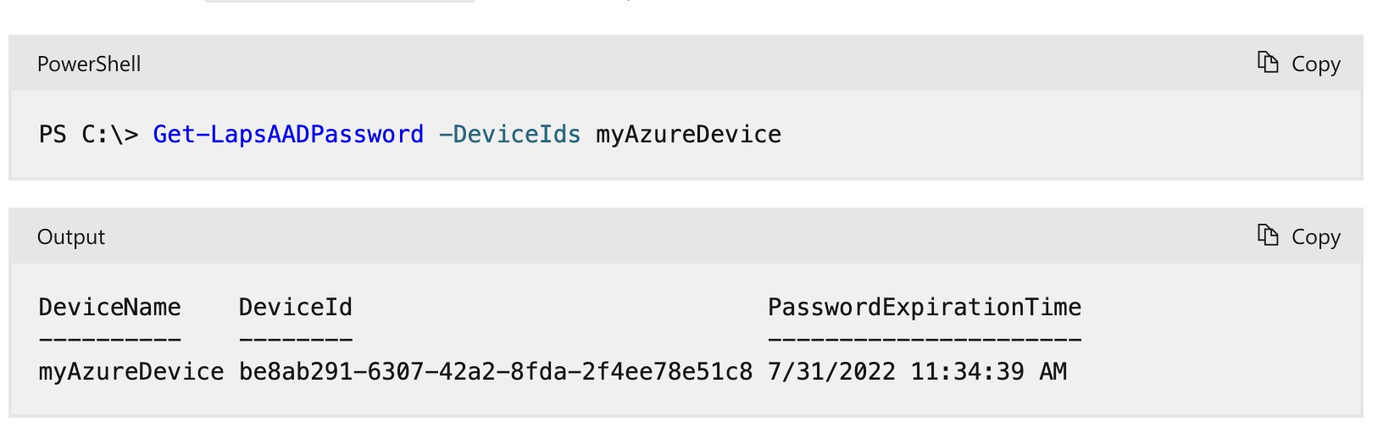
List a device
Windows Server 2025 | Chapter 16 | Windows LAPS
17

Slide 18
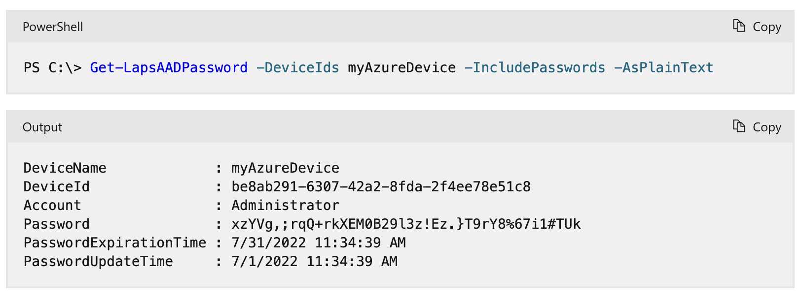
Retrieve the LAPS password
Windows Server 2025 | Chapter 16 | Windows LAPS
18

Slide 19
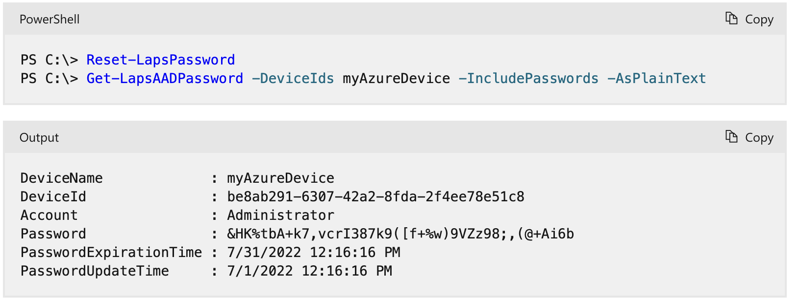
Rotate a Password
Windows Server 2025 | Chapter 16 | Windows LAPS
19

Slide 20
How LAPS works
Password lifecycle:
1
Generate
LAPS client generates random password.
2
Store
Password stored securely in directory.
3
Rotate
Password rotated on schedule (policy).
4
Retrieve
Admin retrieves password when required.
Windows Server 2025 | Chapter 16 | Windows LAPS
20

Slide 21
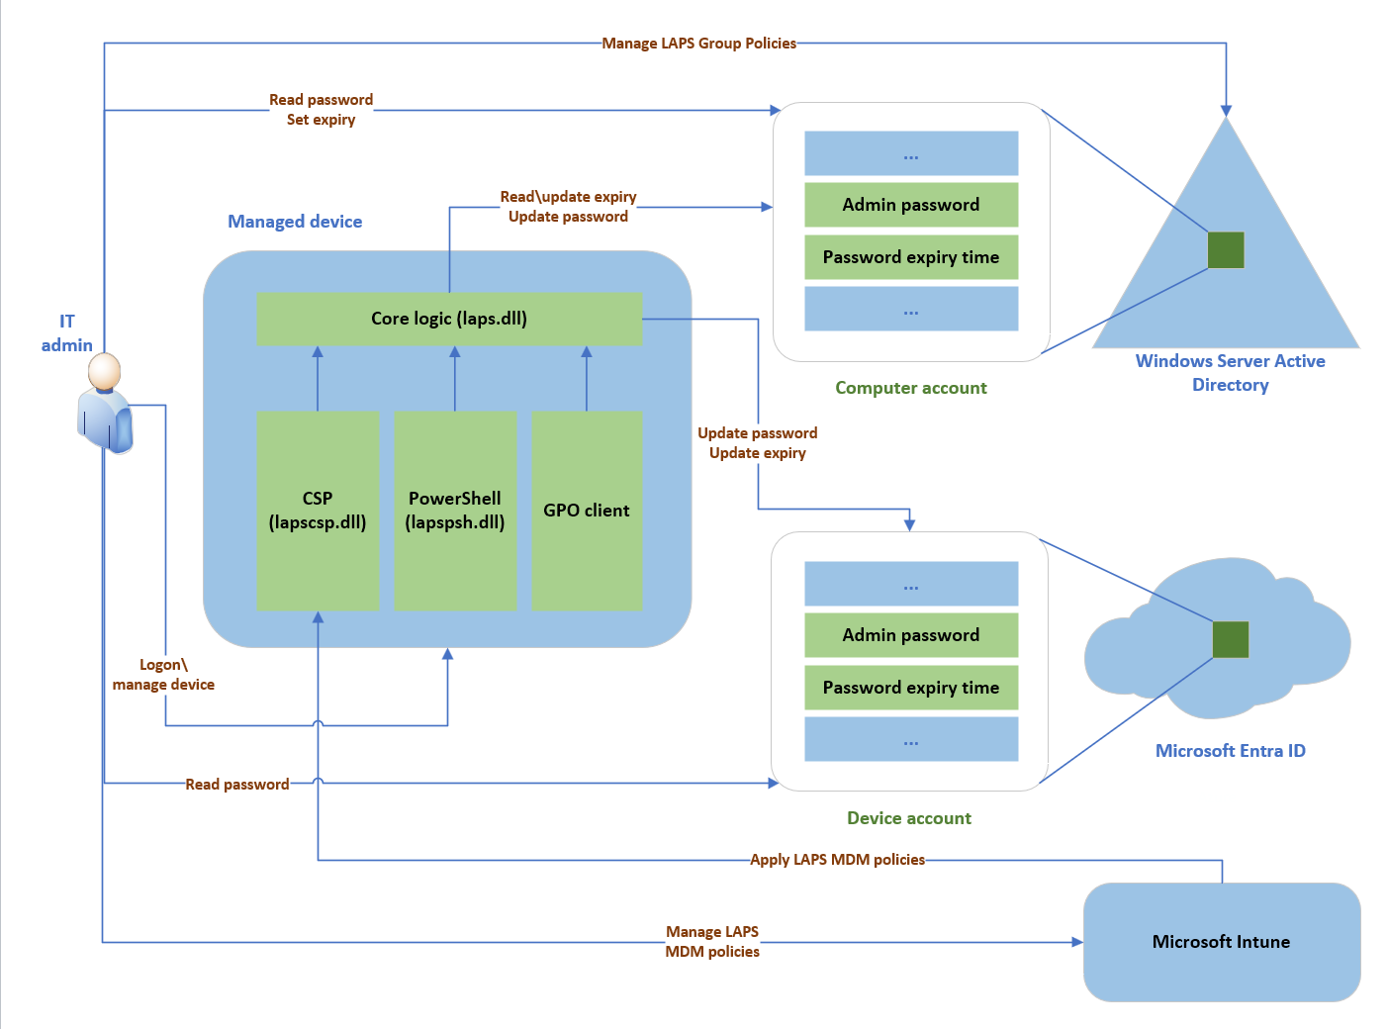
LAPS Policy Processing
Windows Server 2025 | Chapter 16 | Windows LAPS
21

Slide 22
Background policy processing cycle
https://learn.microsoft.com/en-us/windows-server/identity/laps/laps-concepts-overview
Windows LAPS uses a background task that wakes up every hour to process the currently active policy. This task isn't implemented with a Windows Task Scheduler task and isn't configurable.
Windows Server 2025 | Chapter 16 | Windows LAPS
22

Slide 23
Manually start the policy processing cycle
Windows LAPS does respond to Group Policy change notifications. You can manually start the policy processing cycle in two ways:
gpupdate.exe /target:computer /force
Invoke-LapsPolicyProcessing
Windows Server 2025 | Chapter 16 | Windows LAPS
23

Slide 24
Knowledge Check
1
What is the main administrative purpose of Introduction to Windows LAPS?
2
What is the main administrative purpose of Managing local administrator passwords securely?
3
What is the main administrative purpose of Configuring LAPS policies?
4
What is the main administrative purpose of Password rotation and retrieval?
Windows Server 2025 | Chapter 16 | Windows LAPS
24

Slide 25
PRACTICE LAB
Lab 1601
Configuring Local Administrator Password Solution
In this lab, you will configure Windows LAPS (Local Administrator Password Solution) to securely manage local administrator passwords across your domain. LAPS automatically manages local admin passwords and stores them in Active Directory for audited retrieval.
Windows Server 2025 | Chapter 16 | Windows LAPS
25

